Slide 1
FEMU 실습 Cheap, Accurate, Scalable and Extensible Flash EMUlator
28 Feb 2022
IN HO SONG
mearrong123@gmail.com

Slide 2

Chapter Objectives
Background (FEMU & ZNS SSD)
FEMU
ZNS SSD
interface & I/O stack
Experiment
ZNS SSD Mapping method
Open Channel SSD
Make another ZNS SSD in FEMU
HotStorage(March ‘29)?
원본 그림 : [여기]

Slide 3
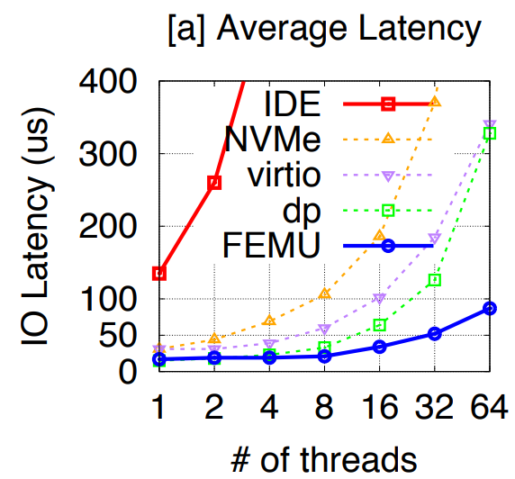
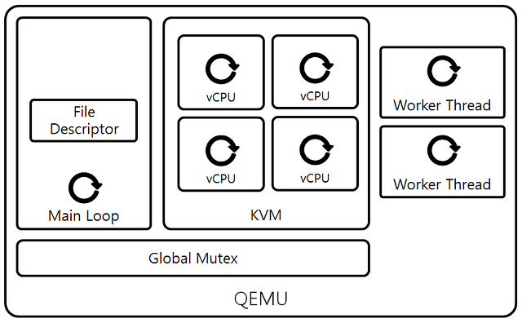
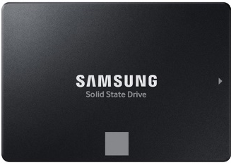
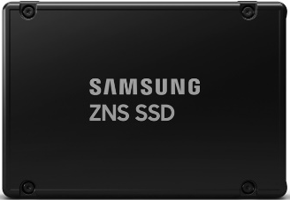
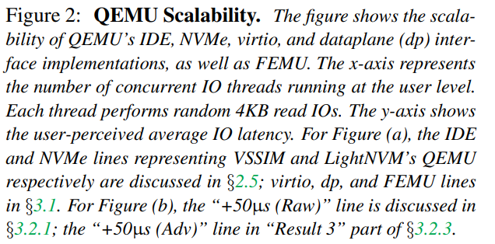
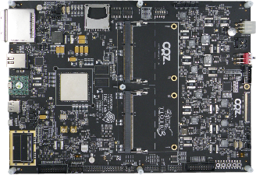
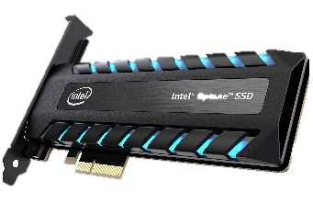
FEMU
1.
QEMU-based open source
Flash Emulator
2.
Exposed 4 types of SSDs
3.
Scalable, Accurate Flash Emulator
Commodity ₁
ZNS ₂
Source : https://ssup2.github.io/theory_analysis/QEMU_KVM/
Open Channel ₃
Optane ₄
₁ https://news.samsung.com/kr/삼성전자-소비자용-ssd-870-evo-글로벌-출시
Source : https://ssup2.github.io/theory_analysis/QEMU_KVM/
₂ https://news.samsung.com/kr/삼성전자-차세대-기업-서버용-zns-ssd-출시
₃ http://openssd.io/
₄ https://www.intel.co.kr/content/www/kr/ko/products/details/memory-storage/consumer-ssds/optane-ssd-9-series.html

Slide 4
ZNS SSD
App #1
App #2
App #1
App #2
SSD Controller
ZNS Controller
FTL
NAND Controller
4 channels
4 channels
zone
zone
page
page
block
block

Slide 5
ZNS SSD
ZNS Channel Configuration : 1 to All
ZNS Controller
4 channels
zone
zone
page
block

Slide 6
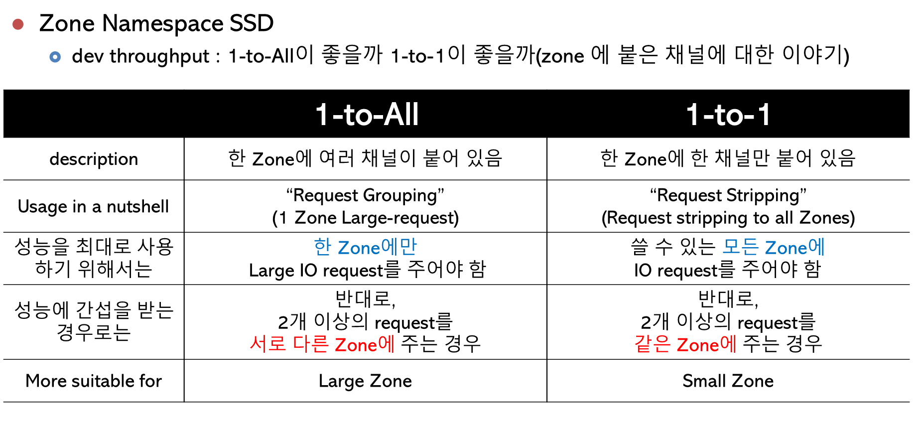
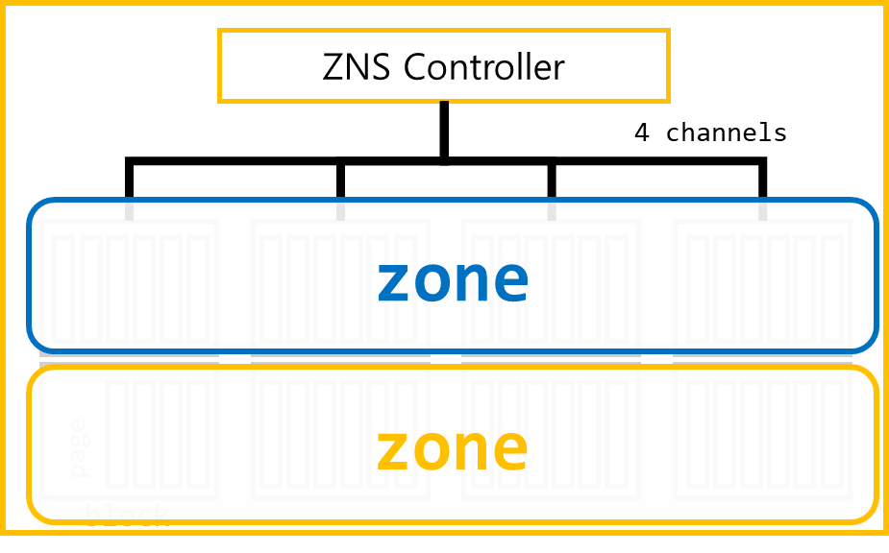
ZNS SSD
ZNS Channel Configuration : 1 to All
ZNS : 1-to-ALL

Slide 7
ZNS SSD
ZNS Channel Configuration : 1 to 1
ZNS Controller
4 channels
zone
zone
page
block

Slide 8

ZNS SSD
ZNS Channel Configuration : 1 to $\frac{\# of Channels}{\# of apps}$
ZNS Controller
4 channels
zone
zone
page
block

Slide 9
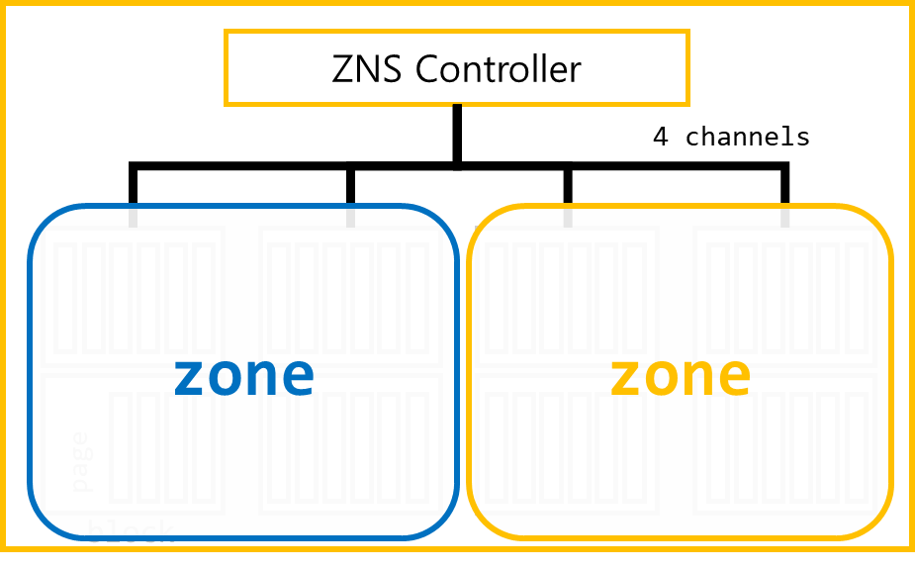
ZNS SSD
ZNS Channel Configuration : 1 to $\frac{\# of Channels}{\# of apps}$
ZNS : 1-to-1

Slide 10
ZNS SSD
ZNS Channel Configuration

Slide 11
ZNS SSD
ZNS Channel Configuration : 1-to-1
We can allocate channels based-on application’s characteristic
Throughput
Sensitive App
T-App
L-App
Latency
Sensitive App
ZNS Controller
4 channels
zone
zone
page
block

Slide 12
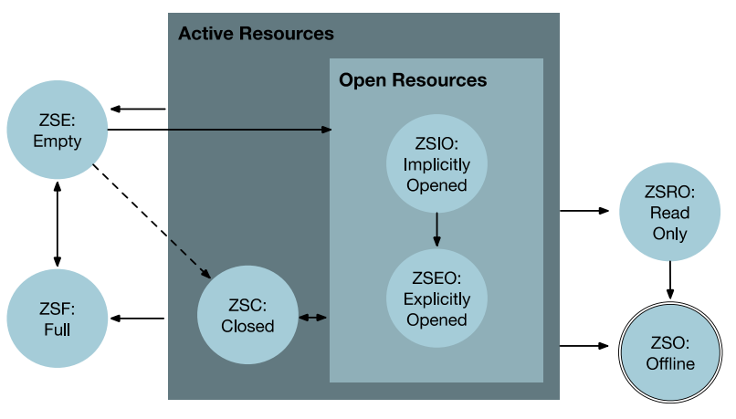
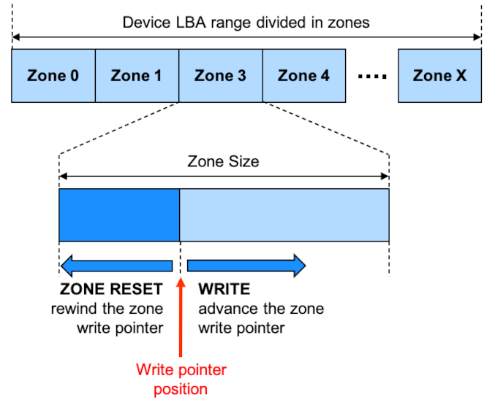
ZNS Interface & I/O stack in FEMU
SOURCE:https://zonedstorage.io/docs/introduction/zoned-storage
ZNS SSD : ZNS, ZNS+, ….
library : LibOS, zbc, zbd, nvme
FS : ZoneFS, F2FS(ZNS, ZNS+), ext4
qemu
PCIe, virtio
Kernel (Guest)
Zone State Machine
nvme controller
(FemuCtrl
femu.c, zns.c)
libzbd
NVMe Device Driver
2
1
S
C
11
10
3
9
dram.c
(backend_rw())
QEMU
FEMU NVMe Emulation
QEMU DMA Emulation
8
4
FEMU Heap Storage
5
dma.c
Zone Storage Device Principle

Slide 13
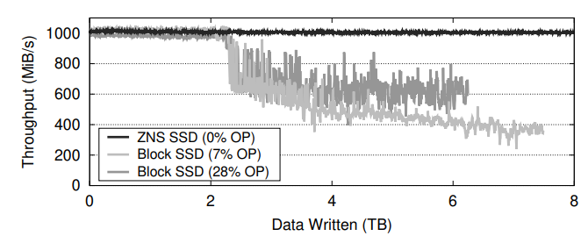



Experiment(예상결과)
“Especially, ZNS 1-to-1 channel mapping make applications configure their QoS(L-app/T-app)”
“In general, ZNS guarantees better QoS for applications”
Throughput
d
d
T-app
L-app
latency
Matias Bjørling, et al., ZNS: Avoiding the Block Interface Tax for Flash-based SSDs, ATC’21

Slide 14
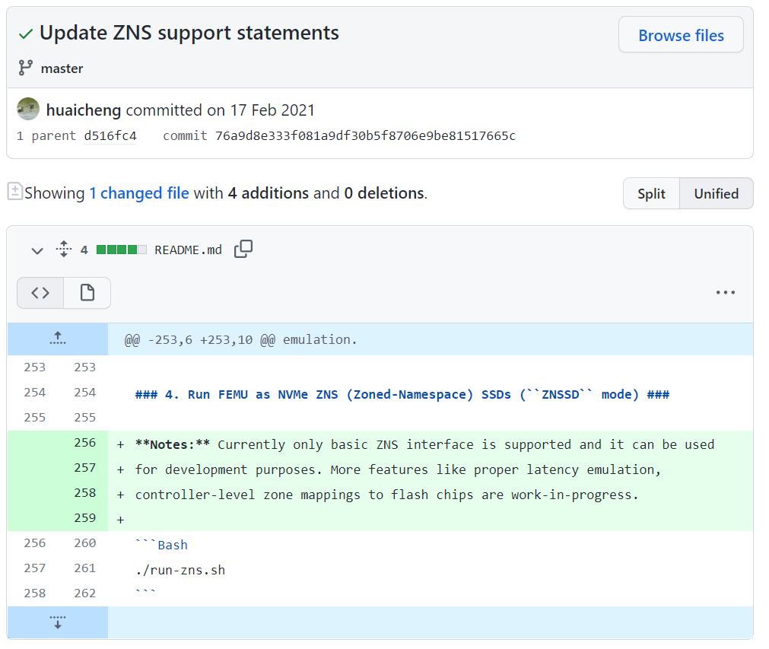
Experiment
https://github.com/ucare-uchicago/FEMU/commit/76a9d8e333f081a9df30b5f8706e9be81517665c

Slide 15
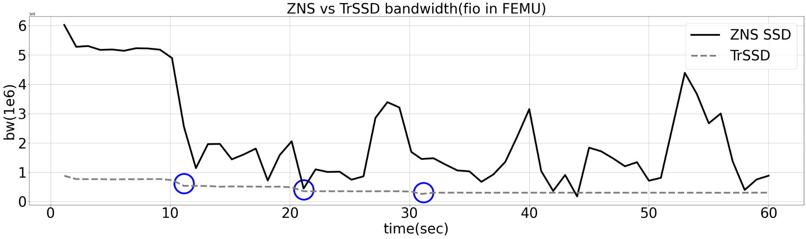
Experiment(실제결과)
TrSSD vs ZNS SSD
(Write Heavy)
Worker 2
Worker 3
Worker 4

Slide 16
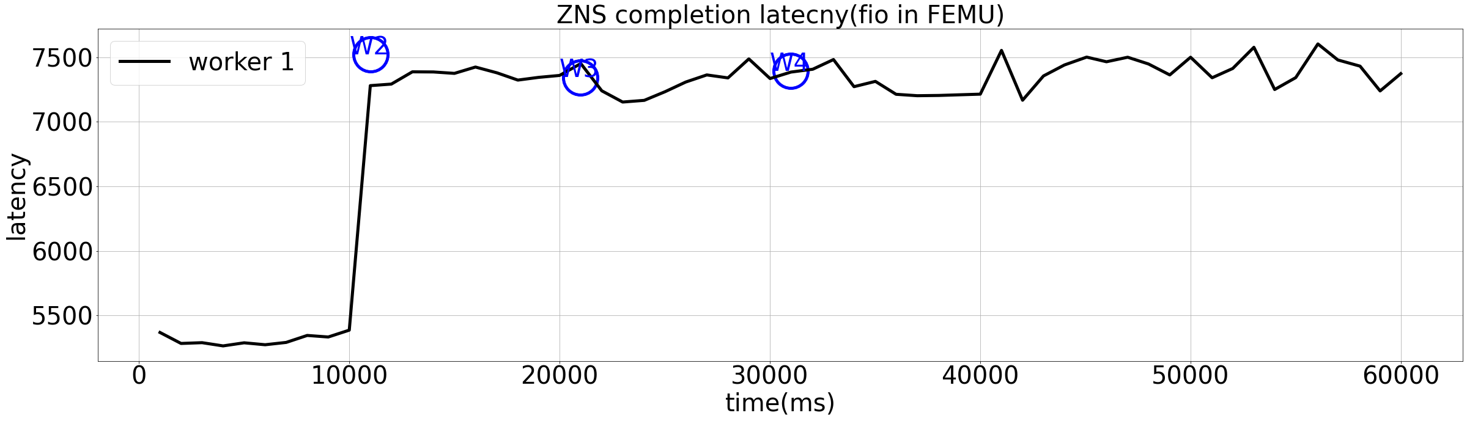
Experiment(실제결과)
TrSSD vs ZNS SSD
(write 128MB)
Worker 2
Worker 3
Worker 4
Worker 1
Worker 2
Worker 3
Worker 4
Zone
Zone
Zone
Zone
zonesize = 128MB

Slide 17
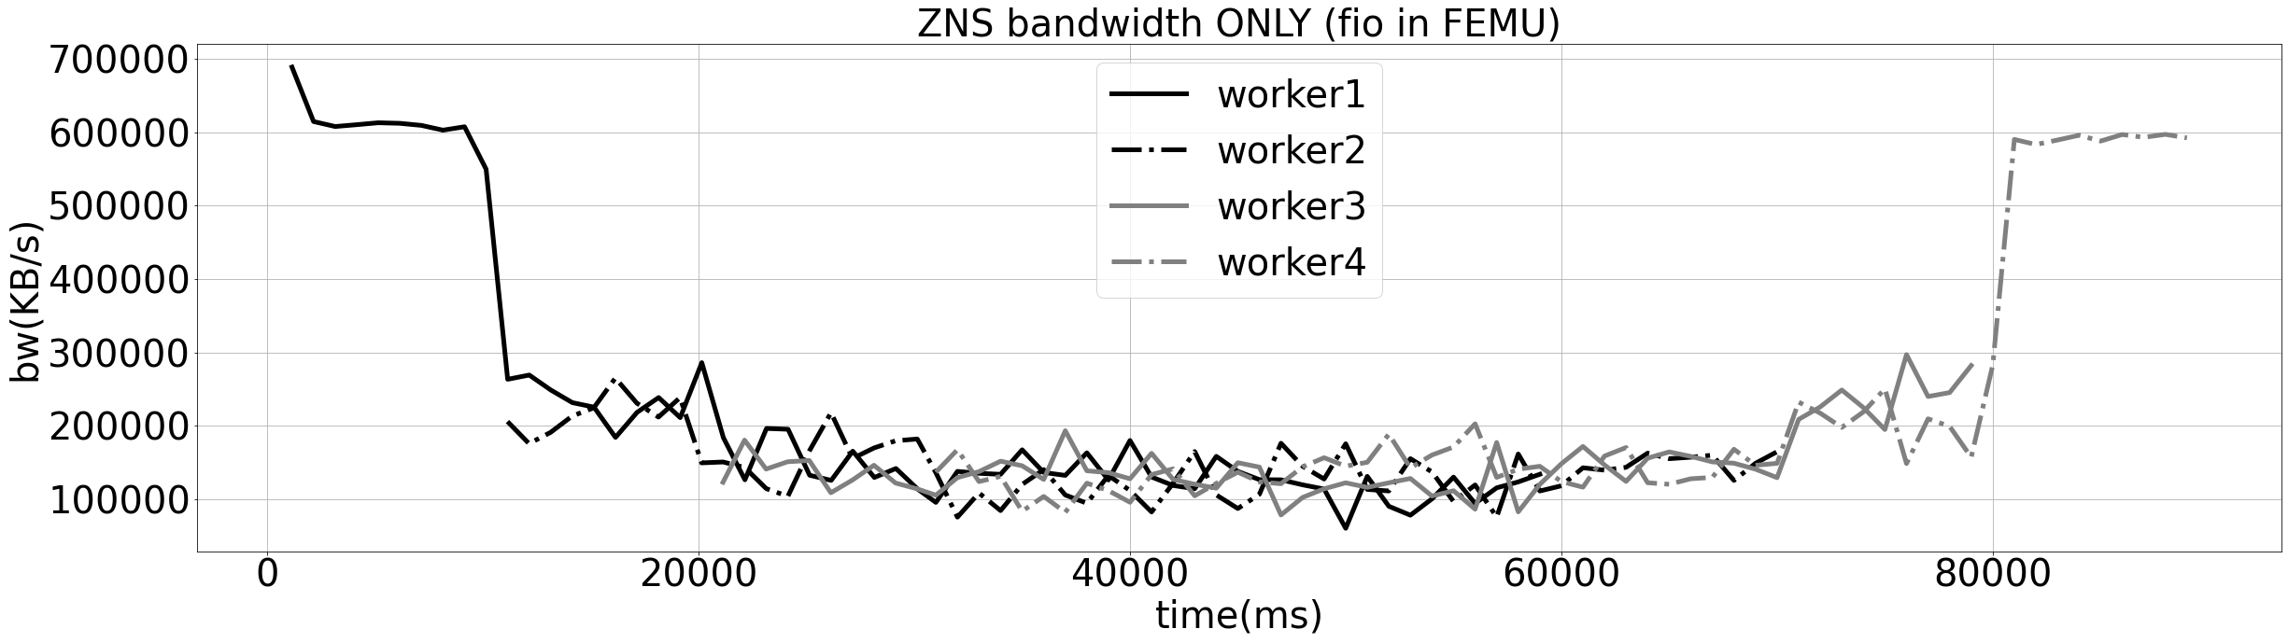
Experiment(실제결과)
TrSSD vs ZNS SSD
(write 128MB)
Worker 1
Worker 2
Worker 3
Worker 4
Zone
Zone
Zone
Zone
zonesize = 128MB

Slide 18
ZNS SSD Mapping method
OpenSouce Contribution :
Make ZNS SSD latency emulation & controller zone mapping method
ZNS+ way :
Make OCSSD to ZNS SSD

Slide 19
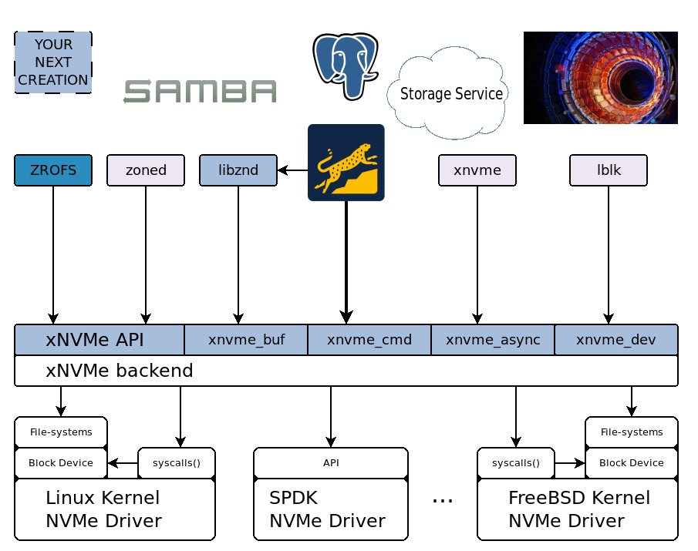
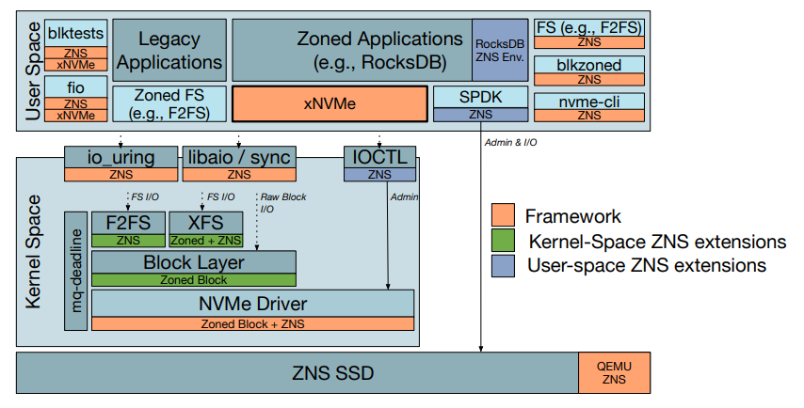
about xNVMe
https://www.snia.org/sites/default/files/SDCEMEA/2020/3%20-%20Javier%20Gonzalez%20Zoned%20namespacese.PDF
https://xnvme.io/

Slide 20
References
[1] https://github.com/ucare-uchicago/FEMU
[2] Li, Huaicheng, et al. "The CASE of FEMU: Cheap, accurate, scalable and extensible flash emulator." FAST’ 18
[3] KVM, QEMU https://ssup2.github.io/theory_analysis/QEMU_KVM/
[4] I/O Virtualization Software https://ssup2.github.io/theory_analysis/IO_Virtualization_Software/
[5] QEMU NVMe Emulation https://qemu-project.gitlab.io/qemu/system/devices/nvme.html
[6] VirtIO https://lolki.tistory.com/3

Slide 21
Q & A
Background (FEMU & ZNS SSD)
FEMU
ZNS SSD
interface & I/O stack
Experiment
ZNS SSD Mapping method
Open Channel SSD
Make another ZNS SSD in FEMU
HotStorage(March ‘29)?

Slide 22
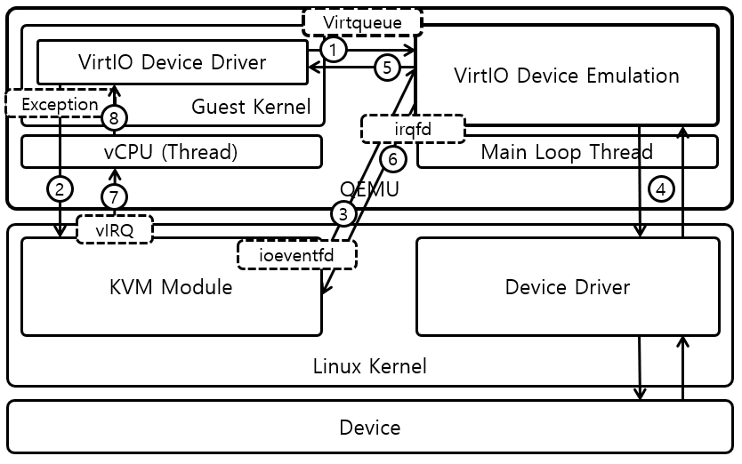
Appnedix : VirtIO
How VirtIO works?
virtio
(https://selfish-developer.com/entry/virtio)
QEMU에서 Full virtualization → 매번 Guest명령어를 트랩, 장치를 에뮬레이션→ 느림(Guest가 Host에 비해 엄청나게 느려짐)
이를위해서 Hypervisor와 Guest가 트랩 없이 통신할 수 있는 채널을 만듬→Guest에서는 frontend driver, Hypervisor에는 backend driver가 필요하게 됨

